Slide 1
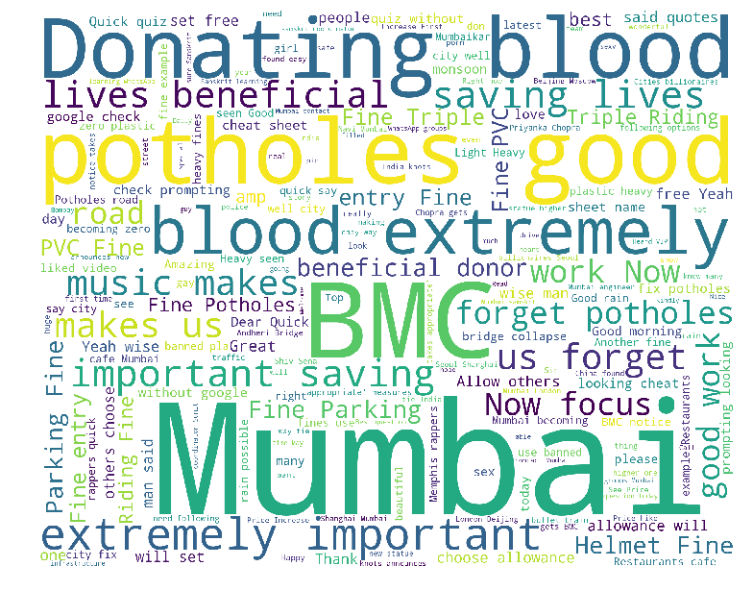
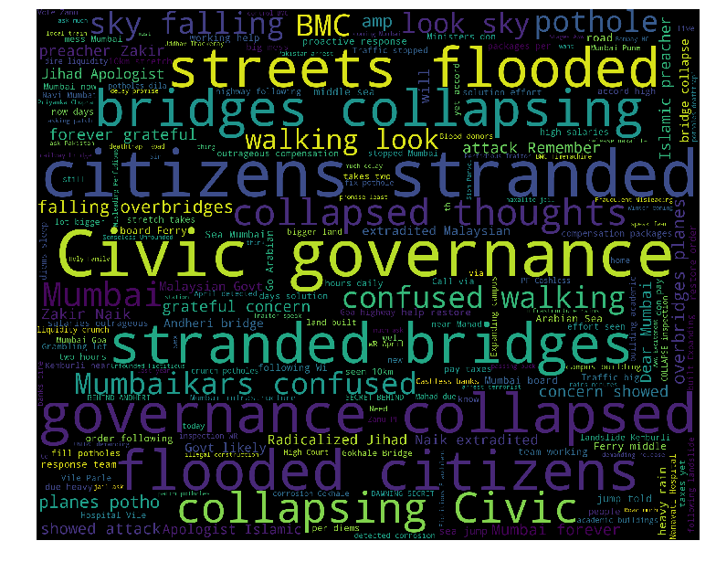
Sentiment analysis
sentiment analysis mumbai rainfall INCIDENT
Use of Sentiment Analysis
Questions that got answered
It can be used for social media monitoring, understanding general public sentiment in aggregate towards events. Using data from social media, emerging topics/trends, potential influencers and other consumer insights can be derived.
What is aggregate emotion of people towards recent events that are occurring in Mumbai?
Language and type of words used to express emotion.
Benefit to Business:
Social media monitoring can be used to derive actionable insights by knowing how public feels in regard to particular events.
Enables civic bodies to assess current situation and prepare for upcoming events proactively and respond to such events in rapid manner.

Slide 2
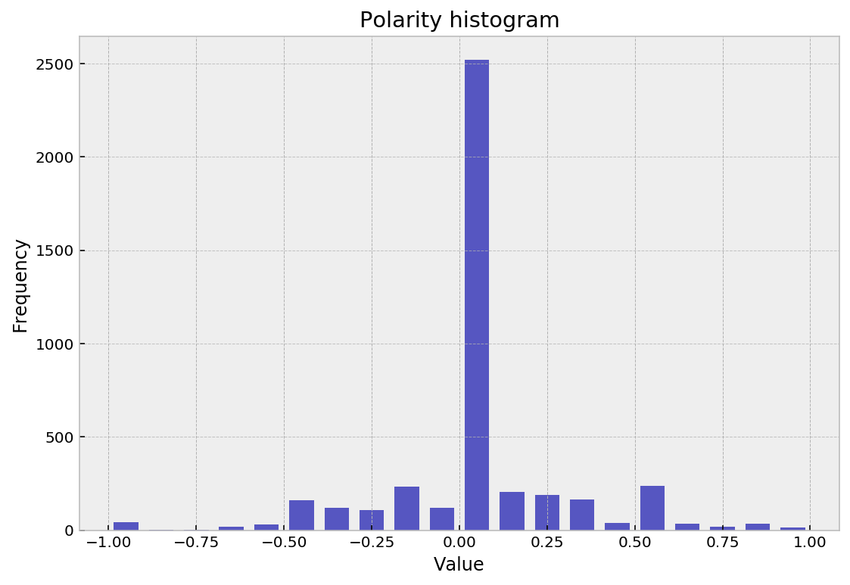
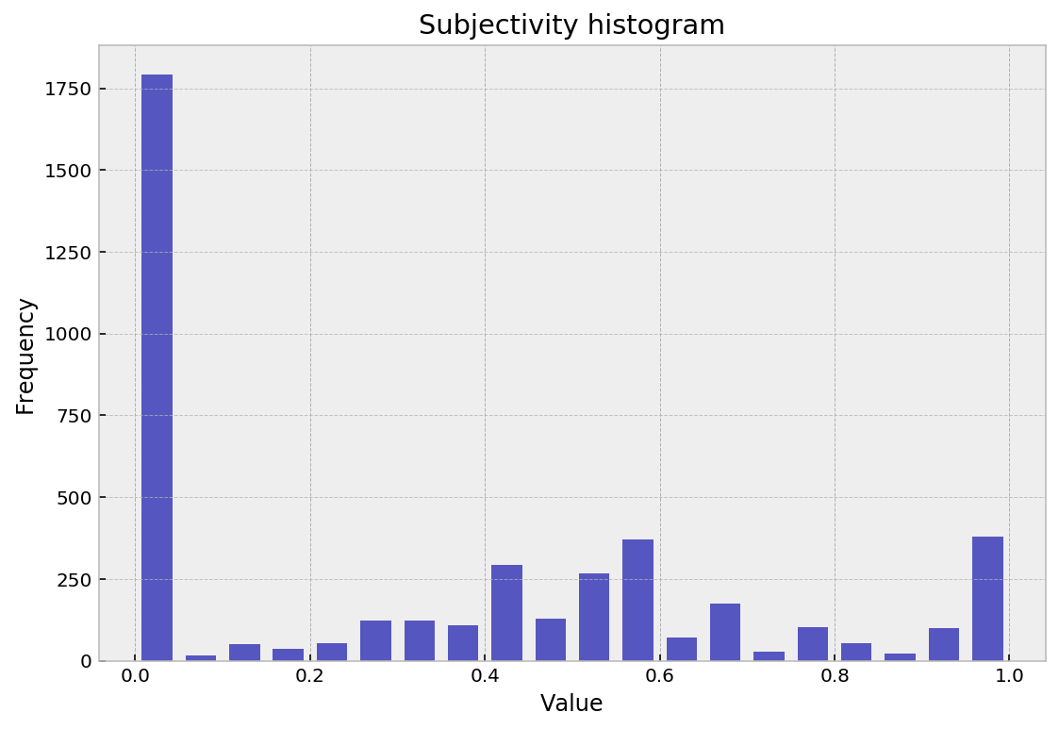
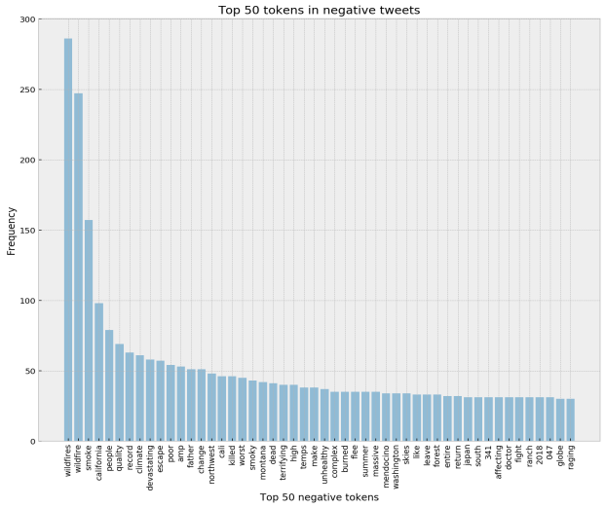
Sentiment analysis
sentiment analysis US Wildfire event
Use of Sentiment Analysis
Questions that got answered
By studying polarity and subjectivity overall sentiments of people towards wildfire can be estimated. This can reveal impact caused by wildfires on lives of people.
Overall emotion of people. Are they positive, negative or neutral?
Top ‘N’ analysis of words used in positive and negative tweets.
Benefit to Business:
Collecting and processing real-time data from social media sources. Generating insights or automated reports at defined intervals.
Predictive models can be build using collected data which can be used to predict sentiment of user from future unseen text.

Slide 3
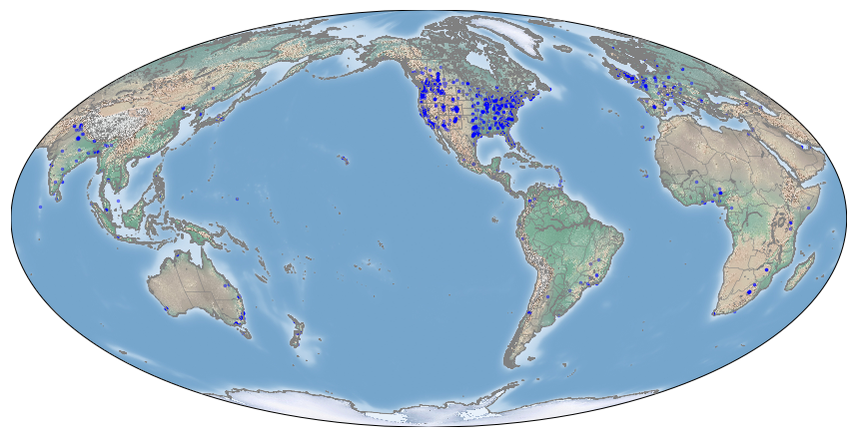
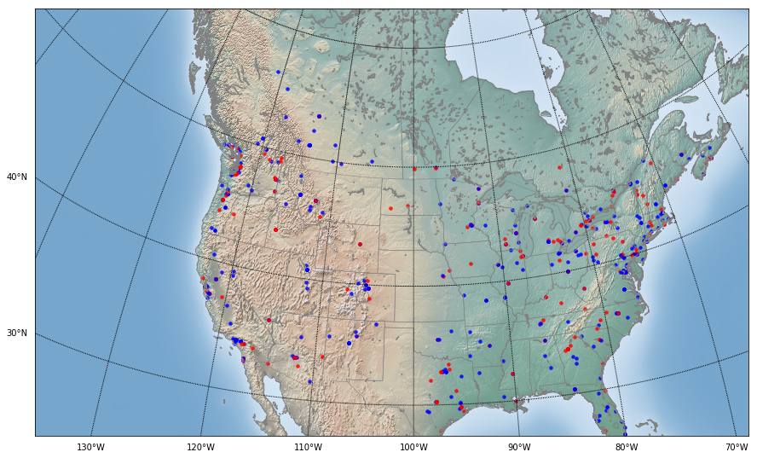
Sentiment analysis
visualization
Use of Sentiment Analysis
Questions that got answered
Dramatically improve ability to interpret information from data. Reveal data patterns that are not possible to capture by looking at tabular data stored in rows and columns.;
Geographic location from where most users are tweeting.
How are positive and negative tweets distributed geographically?
Benefit to Business:
Understanding how people are feeling or responding to events in particular region can help you optimize market strategy.
Can be used to find target audience, adjust marketing campaigns and boost sales revenue.

